Slide 1
Heat Transfer
Thermal Management of a Circuit Board
Mechanical Engineering
Team Plan B
Austin Dionne
Greg Hovagim
Carlos Lazo
Nate Soule

Slide 2
Problem Statement
Perform thermal analysis of current circuit design
  Calculate steady-state temperature across the board
  Calculate steady-state junction temperature for each component
Produce an alternative circuit design
  Must meet thermal and design requirements
    Maximum junction temperature must be below 105°C
    Devices may not be placed within 0.25’’ of any edge, or any other device
  Provide thermal design recommendations

Slide 3
Assumptions
Top/bottom edges have zero heat flow
Board temperature for each device is the average temperature of the board under the device
All components operate continuously at a constant power dissipation
During operation the temperature will remain constant at all points on the board, e.g. steady-state
Conduction across the board is two-dimensional
Thermal conductivity is constant across the board

Slide 4
Method of Analysis
Implemented the Finite Difference (FD) method using Excel to model the thermal profile of the circuit board
  Circuit board divided into 21x21 mesh of nodes spaced 0.5’’ apart
  Utilized Successive Over-Relaxation technique to decrease settling time
  Initial temperature for each node was set to _____
  Steady-state temperature difference threshold of ______
  Junction temperatures calculated once steady-state was achieved
  …Edge Conditions…

Slide 5

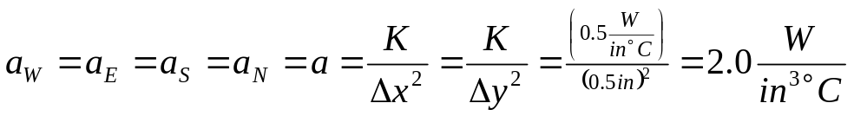
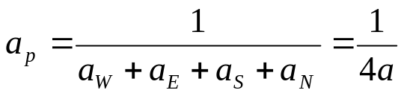
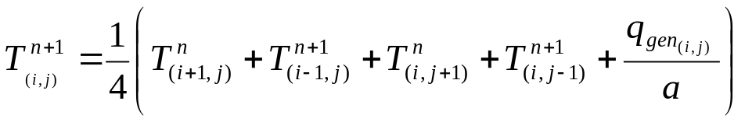
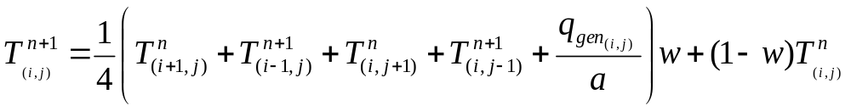
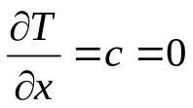
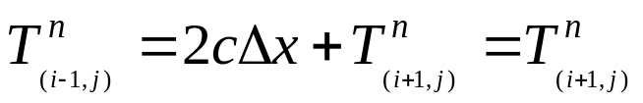
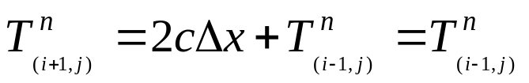
Method of Analysis – Equations Used
Distances Between Nodes
FD Coefficients
FD Iteration Equation
Weighted FD Iteration Equation
Top/Bottom Edge Assumption
Temp. at Top/Bottom Edge

Slide 6
Results - Original (Poor) Design
It really sucked – here is the data:
Why did it suck so bad?
Parts generating the most heat were adjacent and not located adjacent to the edges
Nodes on the board were experiencing excessive heat
What influence did the SOR have?
- I donno
What criteria was it failing against?
- Most importantly, the component junction temperatures exceeded the max allowable temp

Slide 7
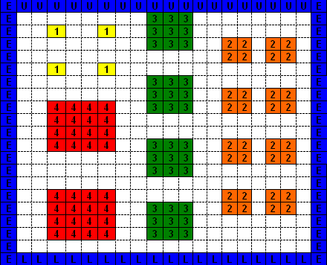

Results - Original (Poor) Design cont’d
Component Arrangement
(Bad Design):

Slide 8
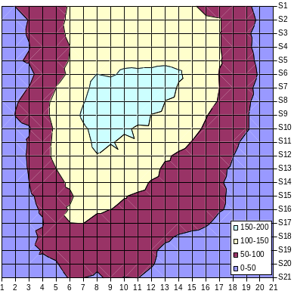
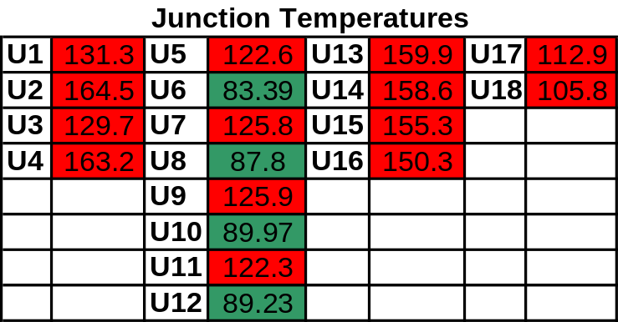
Results - Original (Poor) Design cont’d
Thermal Profile

Slide 9
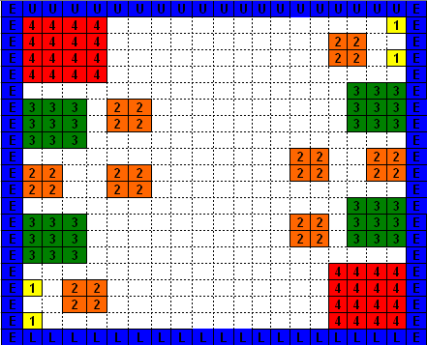
Results - Plan B PCB Layout
New Component Arrangement (Plan B):

Slide 10
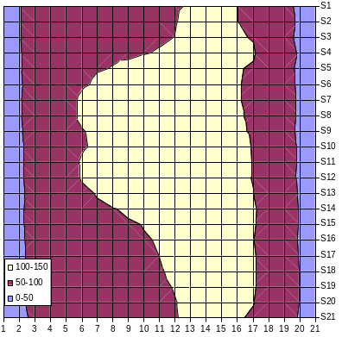
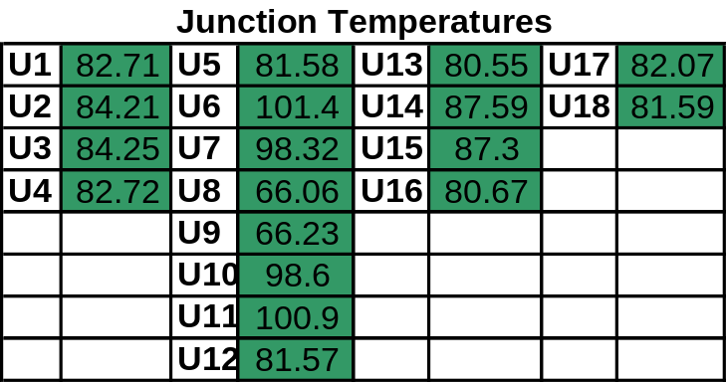
Results - Plan B PCB Layout cont’d
Thermal Profile

Slide 11
Results - Plan B PCB Layout cont’d
Our rockin’ new design

Slide 12
Specific Suggestions for re-design

Slide 13


